Slide 1

POKECLONE DEVOPS CAPSTONE PROJECT
By PokeVets
Docker & Kubernetes Repository
Terraform Repository

Slide 2

TEAM MEMBERS
Edwin Quito
US Marines Veteran, AWS Cloud Practitioner
linkedin.com/in/edwin-quito-331b28291
github.com/epquito
Stephan Lamoureux
US Army Veteran, AWS Cloud Practitioner
linkedin.com/in/stephanlamoureux
github.com/stephanlamoureux
wheresteve.codes
Xinxin Hou
US Army Spouse, Bachelor Degree
www.linkedin.com/in/xinxin-hou-sunshine
github.com/hxin1123

Slide 3
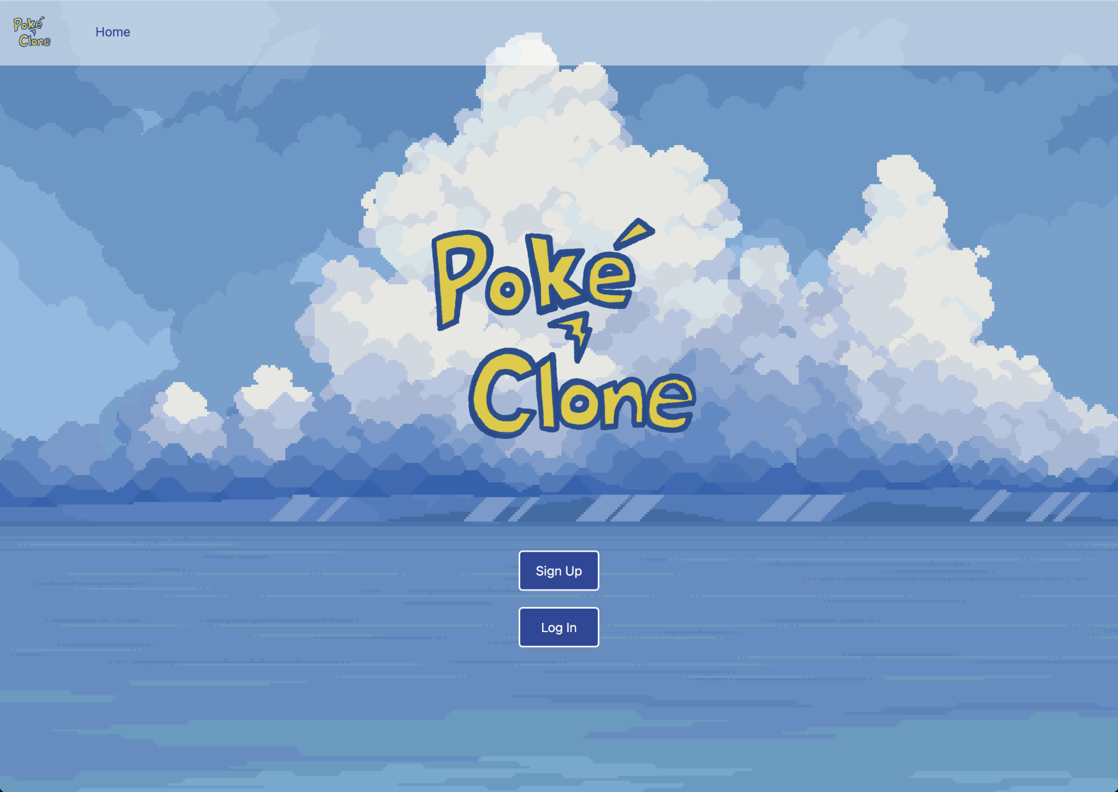
PROJECT REVIEW
Deployed this web application PokeClone, an educational project developed by code platoon team.
PokeClone is a 3 tier deployment combining a React front-end, a Django back-end, and a PostgreSQL database.
The primary focus of the project was to implement DevOps practices to automate, scale, and efficiently deploy the application on the AWS cloud infrastructure. To achieve this, the team employed a variety of technologies including Terraform, Docker, Kubernetes, and various AWS services.

Slide 4

DEMO

Slide 5
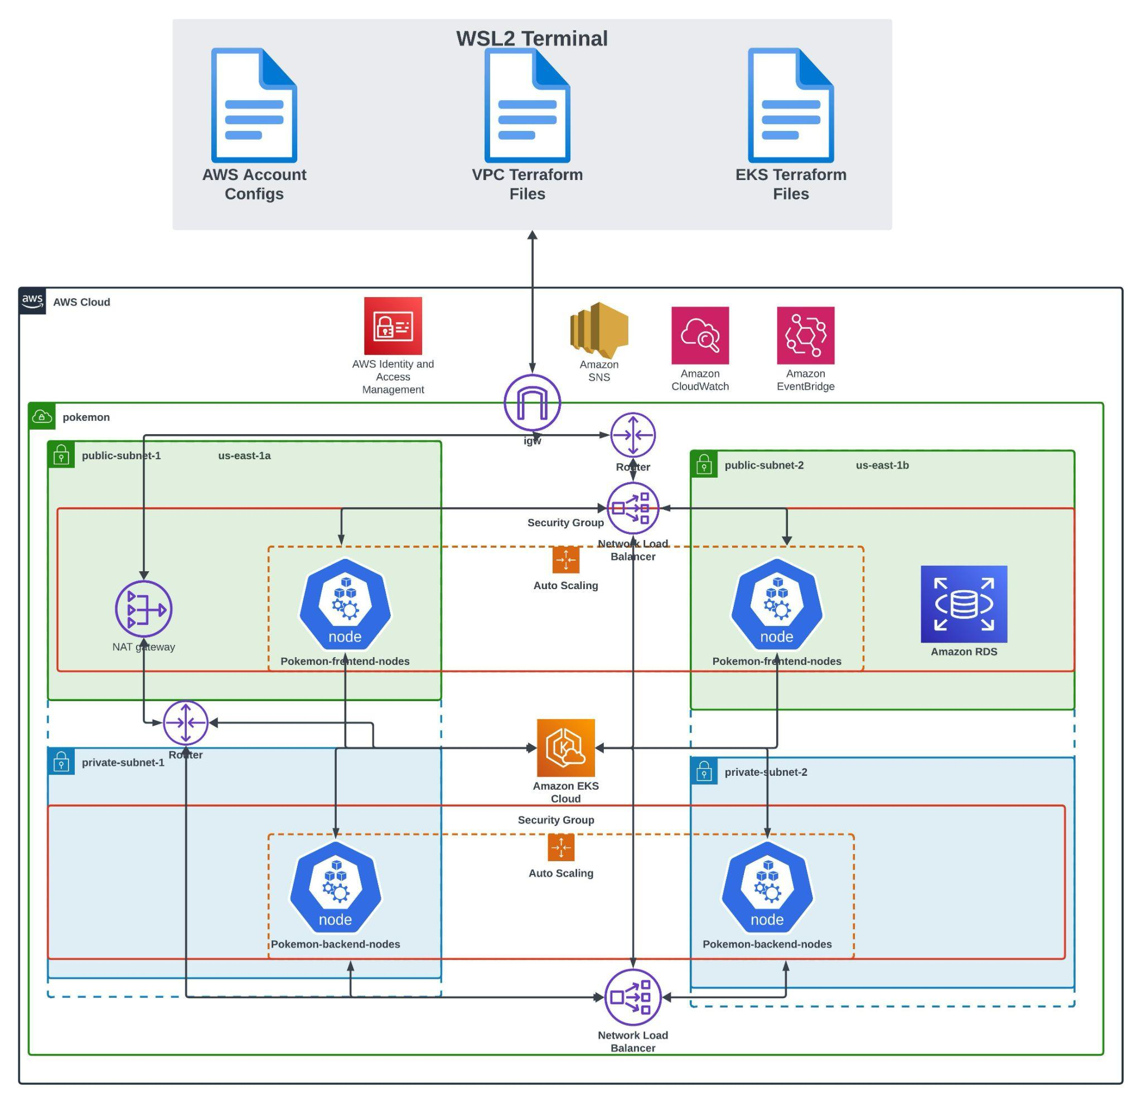
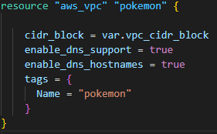
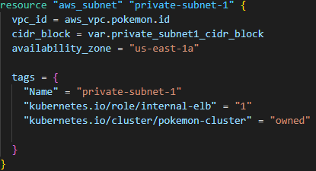
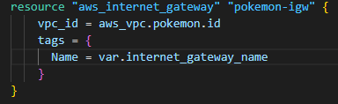
AWS Architecture Diagram Using Terraform(IaC)

Slide 6
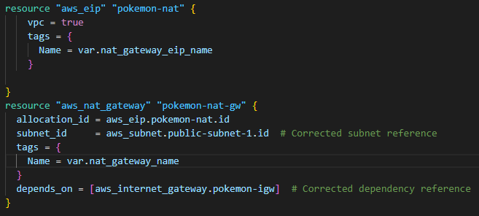
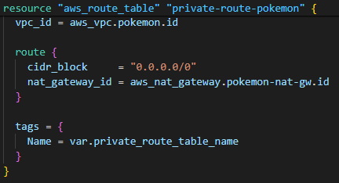
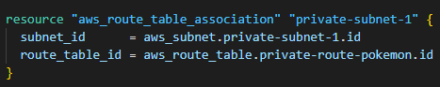
AWS Architecture Diagram Using Terraform(IaC)

Slide 7
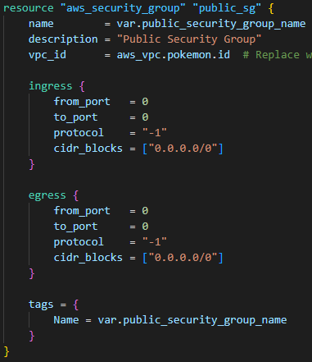
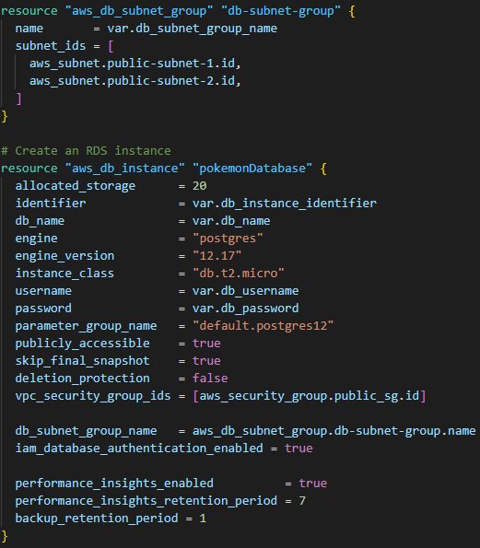
AWS Architecture Diagram Using Terraform(IaC)

Slide 8
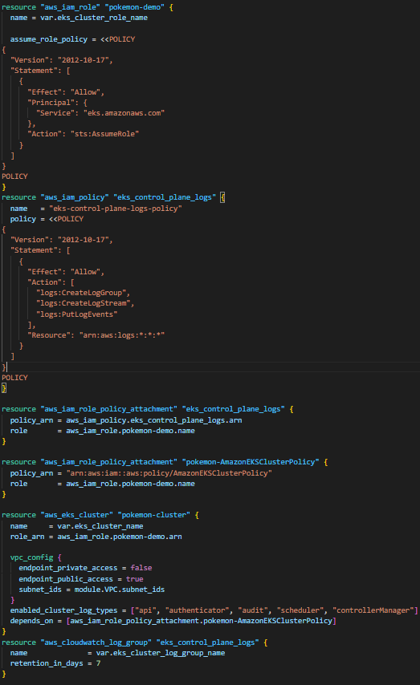
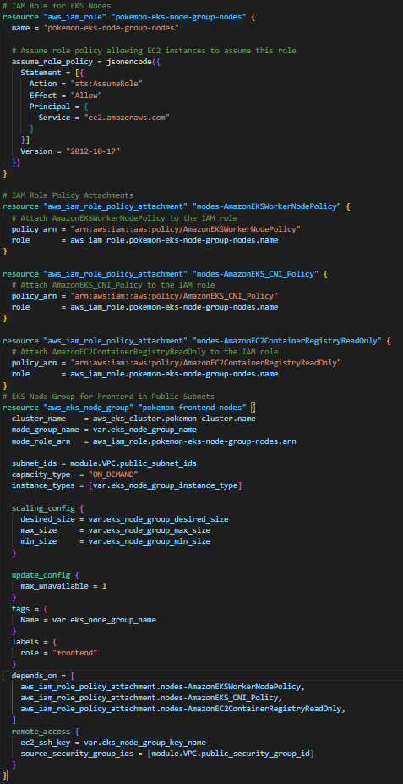
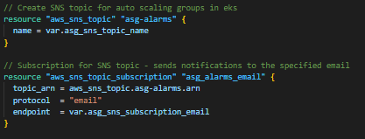
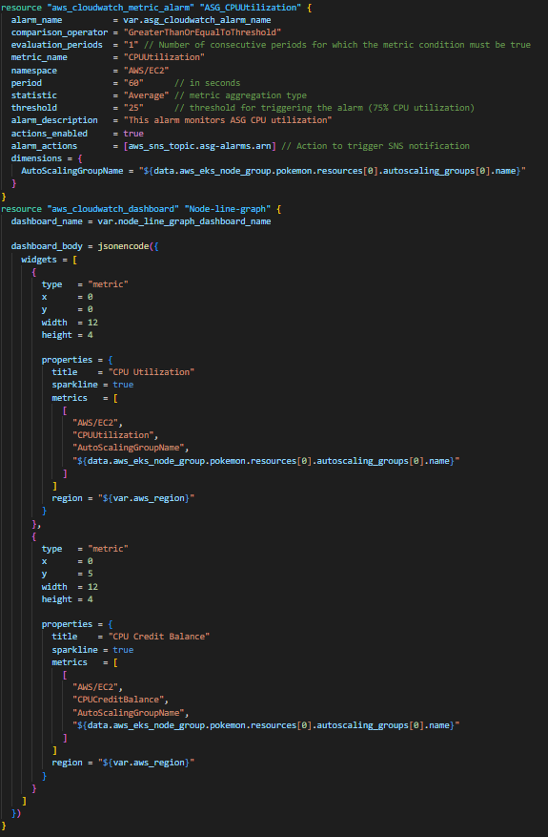
AWS Using Terraform(IaC)

Slide 9
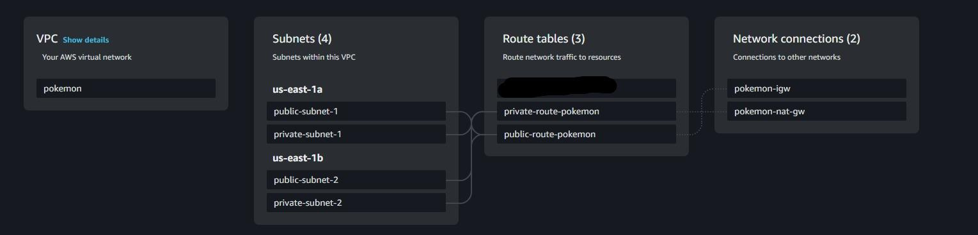
Terraform: Infrastructure As Code For VPC
VPC configuration for the EKS deployment has many network layers.
VPC
Subnets
IGW(Internet Gateway)
Nat Gateway
Route Tables
Security Group
RDS configuration
For simplicity of the deployment we decided to have the RDS configurations and Event Bridge within the VPC module

Slide 10
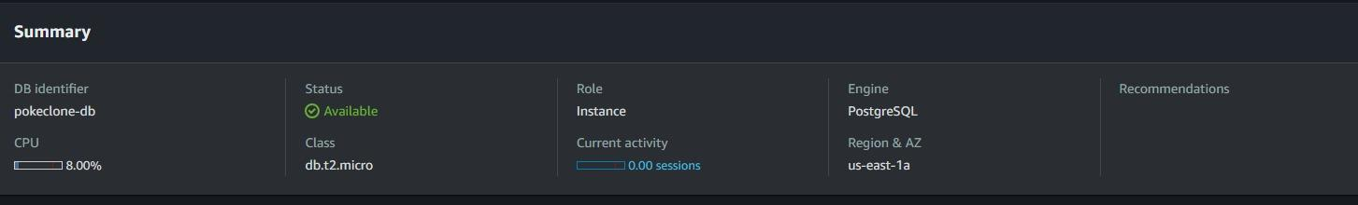
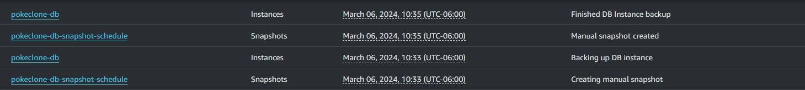
Terraform: Infrastructure As Code For RDS
RDS configuration is a basic deployment of a PostgreSQL database that’s being used for storing information from the Pokeclone application that uses EKS with Configmaps to access the database.
Also creates a snapshot called “pokeclone-db-snapshot-schedule” using AWS EventBridge

Slide 11
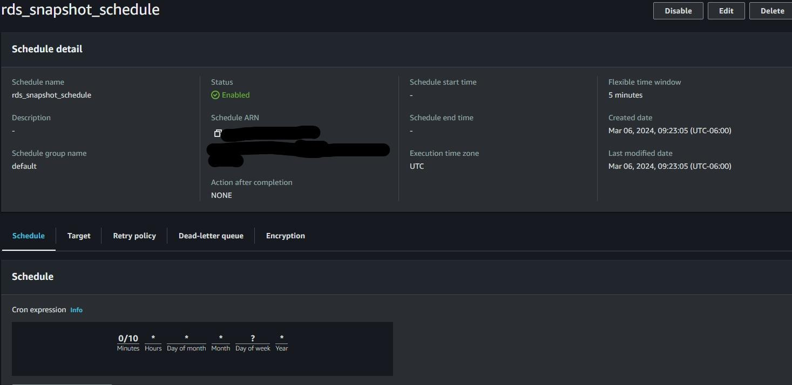
AWS EventBridge
AWS EventBridge schedule creates a snapshot every 10 minutes in this version for testing purposes. The cron schedule will change into a weekly schedule.

Slide 12
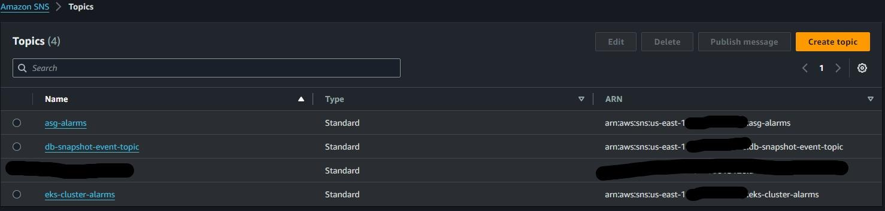
AWS SNS
AWS SNS Topics for DB snapshots, EKS node autoscaling, and EKS cluster.

Slide 13
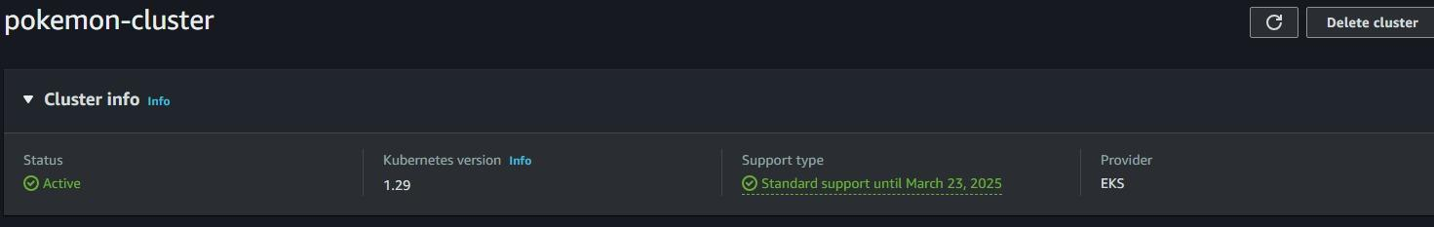
Terraform: Infrastructure As Code EKS
EKS terraform configurations consists of various parts
IAM roles
Worker Nodes
OIDC
EBS CSI
Cloudwatch monitoring/dashboard
Route 53(Couldn’t deploy since the resource is very costly)
All of names listed above are the names of the Terraform configuration files that allow the creation of the cluster

Slide 14
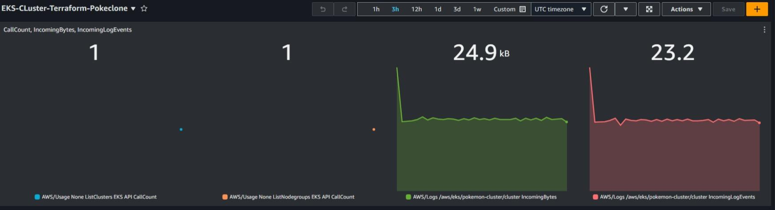
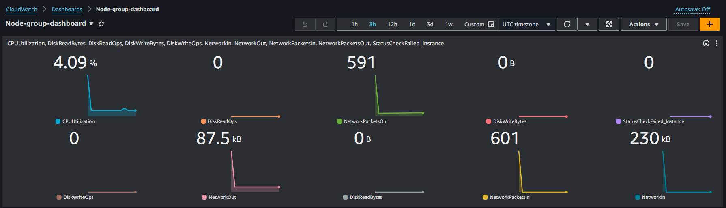
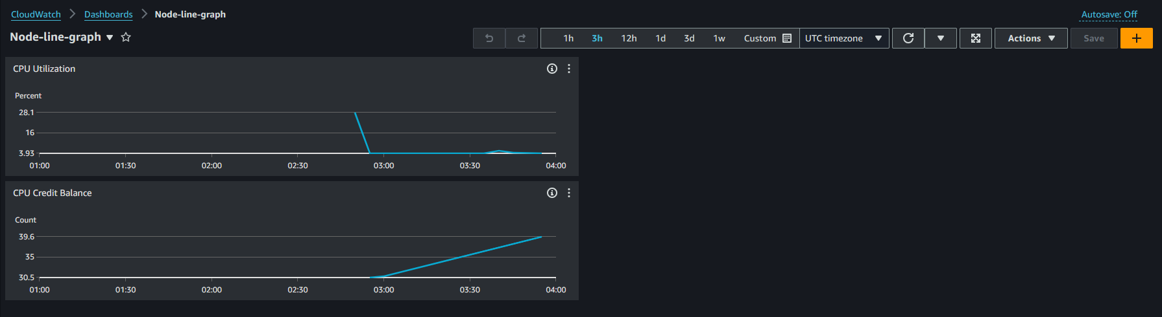
CloudWatch Monitoring Dashboard

Slide 15
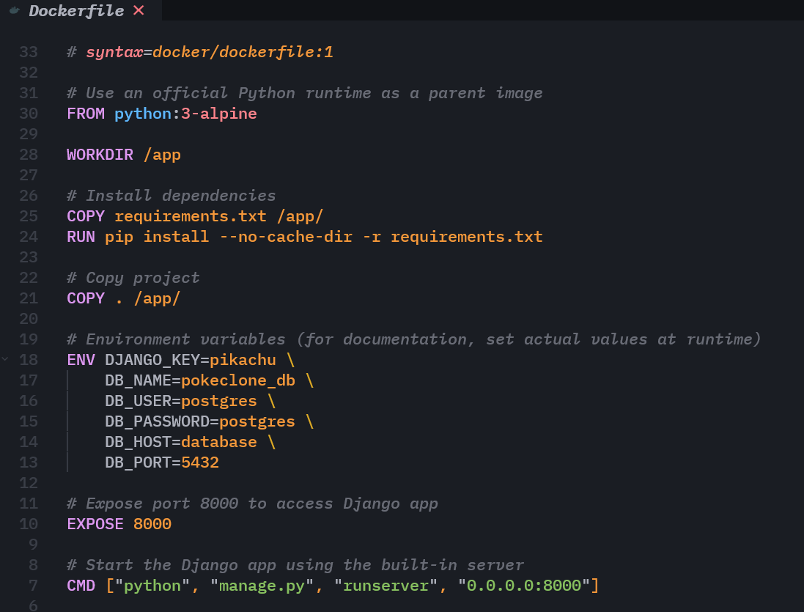
Containerization With Docker
Why use Docker?
Consistency Across Environments
Isolation
Resource Efficiency
Rapid Deployment and Scaling
Version Control and Rollback

Slide 16
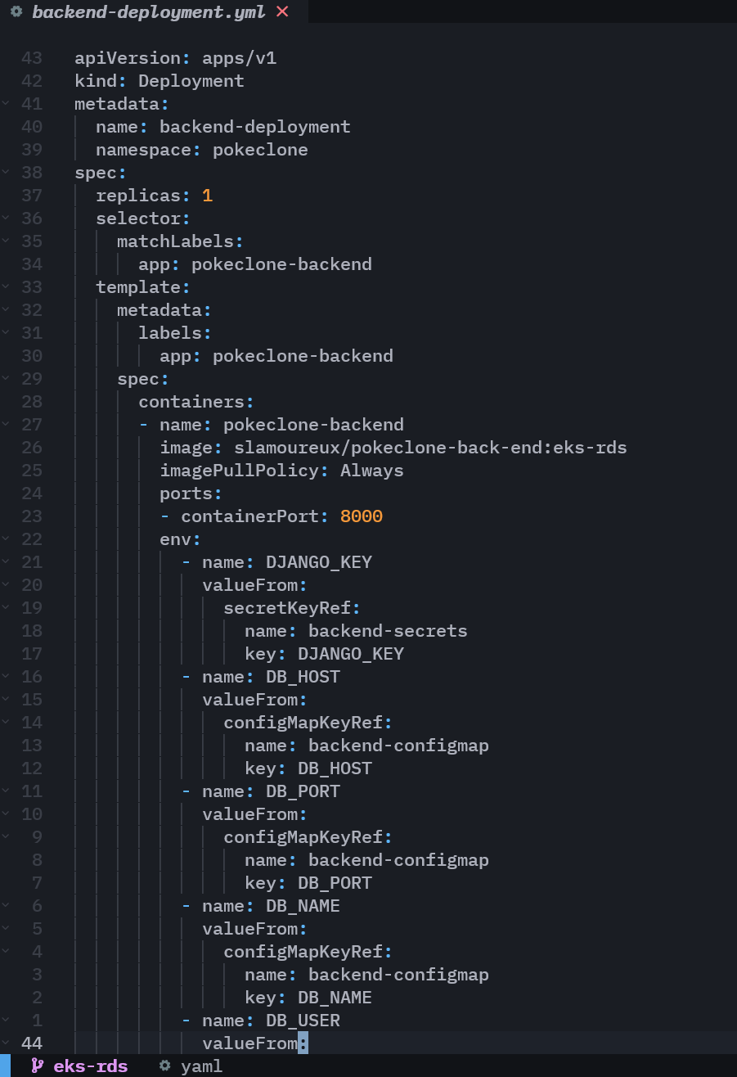
Kubernetes Orchestration
Automates the deployment, scaling, and management of containerized applications, ensuring they run efficiently and resiliently.
Key Benefits:
Scalability
High Availability
Load Balancing
Self-Healing
Configuration Management

Slide 17
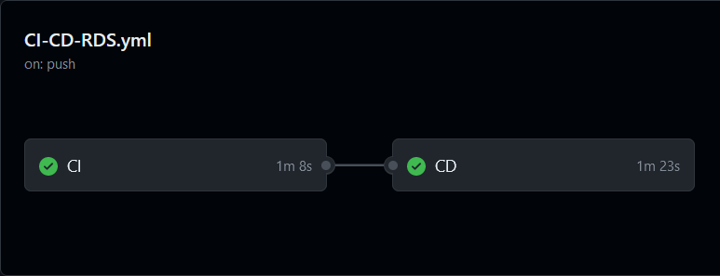
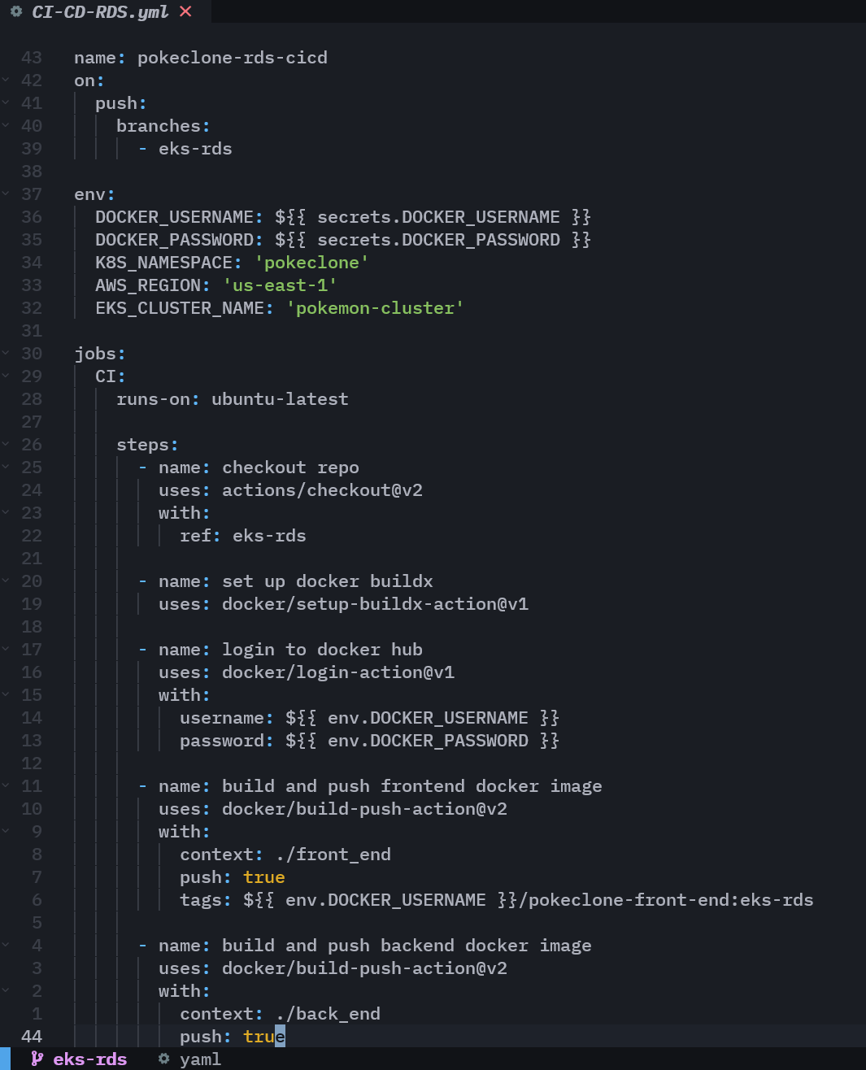
CI/CD With Github Actions
On pushes to the eks-rds branch:
Frontend and backend Docker images are built
The images are pushed to Dockerhub
kubeconfig is updated on the EKS cluster
All Kubernetes files are deployed
Django migrations are applied

Slide 18

QUESTIONS?

